Slide 1
Temporal Databases
VALID-TIME TEMPORAL DATA MODEL
TIME NORMALIZATION
TEMPORAL QUERY LANGUAGE
CONCEPTUAL DESIGN AND LOGICAL DESIGN

Slide 2
What is temporal DB?
Temporal databases, encompass all DB applications that require some aspect of time when organizing their information.
They exhibit the need for developing a set of unifying concepts for application developers to use.
Temporal DB applications have been developed since the early days of database usage. However, in creating these applications, it was mainly left to the application developers to discover, design, program, and implement the temporal concepts.

Slide 3
Applications of temporal db
There are many examples of applications where some aspect of time is needed to maintain the information in a DB.
Health care: patient histories need to be maintained
Insurance: claims and accident histories are required
Finance: stock price histories need to be maintained.
Personnel management: salary and position history need to be maintained
Banking: credit histories

Slide 4
This chapter will introduce some of the concepts that have been developed to deal with the complexity of temporal database applications.
Terminology
Valid time. The valid time denotes when facts are true with respect to the real world.
Transaction time. The transaction time of a database fact is the time when the fact is current in the database.

Slide 5
Unlike valid time, transaction time may be associated with any database entity.
Although time is a continuous value in the real world, for database application, time is usually discretized as timepoints on a timeline.
Chronon. A chronon is the shortest duration of time supported by a temporal DBMS. It is a non-decomposable unit of time.

Slide 6
1. VALID-TIME TEMPORAL DATA MODEL
Temporal database systems typically use relational databases, which provide well-defined data models and query languages. However, the relational model has two significant shortcomings regarding temporal data:
1. The relational model provides poor support for storing complex temporal information.
An example of this shortcoming is that the relational model does not support automatic merging of temporally overlapping data.

Slide 7
2. The SQL query language provides very limited support for expressing temporal queries.
Therefore, applications that work with complex temporal data should define their own
(1) temporal models and
(2) query systems.

Slide 8
Intervals, state tables and event tables
Several extensions to the relational model have been proposed to deal with two above shortcomings.
Valid-time databases: time factor is attached to all tuples in a temporal table.
In valid time databases, two-dimensional relational tables are extended to incorporate time as a third dimension.
In these tables, every tuple holds temporal information denoting the information’s valid time.

Slide 9
Two types of temporal tables:
- event tables, which hold instant timestamps, and
- state tables, which hold interval timestamps.
EX: laboratory-test values are always stored in event tables. Information about drug treatments can be held in state tables.
Temporal data in state table can be represented as intervals, which are bounded by start and stop timepoints.
EX: [d04:d10] is the interval with start timepoint d04 denoting the 4th day and stop timepoint d10 denoting the 10th day.

Slide 10
Interval-extended relational model
Since temporal data in both state tables and event tables can be represented as intervals, we have an interval-stamping method for modeling a temporal DB. A relation in such a database is called a history.
Each tuple will store the temporal dimension of an entity over a closed interval; a pair of columns will be required to represent the endpoints of the interval.
This temporal data model is also called the interval-extended relational model, or historical data model.

Slide 11
Example temporal table
A temporal table SALARY that holds information about employees and their salaries.
Empno | Sal | TE | TS
52 | 18 | 5 | 9
52 | 20 | 10 | 20
52 | 25 | 21 | 38
52 | 31 | 39 | 47
52 | 38 | 48 | Now
97 | 30 | 12 | 17
97 | 35 | 18 | Now

Slide 12
Point Type of intervals
In our temporal data model, timepoints will have only a single granularity, which is at the smallest level of interest in the DB applications.
EX: If granularity is one day, then we can say that the timepoints are all values of type DATE, and type DATE is the point type of intervals.
When we consider an interval value, [d04:d10], the interval includes its begin and end points d04 and d10, by definition.
The interval consists of a set of points arranged in according to some agreed ordering.

Slide 13
A given type T is usable as a point type of all the following are defined for it:
• A total ordering, according to which the infix operator “>” is defined for every pair of values v1 and v2 of type T.
• “first” and “last” operators, which return the smallest and the largest value of T, respectively, according to the above ordering.
• “next” and “prior” operators, which return the successor and the predecessor, respectively, of any given value of type T.

Slide 14
Interval operations
Since intervals are represented as pairs of timepoints, comparisons between intervals are based on timepoint comparisons of the upper and lower bounds.
The interval comparison operators are BEFORE, AFTER, DURING, CONTAINS, OVERLAPS, MEETS, STARTS, FINISHES, and EQUAL. This set of comparisons was originally defined by Allen.
♦Let I1, I2 be two intervals, and begin(I), end(I) be respectively the lower bound and upper bound of the interval I. The definitions of 13 interval comparisons are given in Table 1.

Slide 15
 | Comparison operator | Meaning
1 | I1 before I2 | I1_{E} < I2_{S}
2 | I1 after I2 | I2_{E}<I1_{S}
3 4 | I1 during I2 I1 contains I2 | (I1_{S}>I2_{S} ∧ I1_{E} ≤ I2_{E})∨ (I1_{S}≥I2_{S} ∧ I1_{E} < I2_{E}) (I2_{S}>I1_{S} ∧ I2_{E} ≤ I1_{E}) ∨ (I2_{S}≥I1_{S} ∧ I2_{E} < I1_{E})
5 6 | I1 overlaps I2 I1 overlapped_by I2 | I1_{S} < I2_{S} ∧ I1_{E} > I2_{S} ∧ I1_{E} < I2_{E} I2_{S} < I1_{S} ∧ I2_{E} > I1_{S} ∧ I2_{E} < I1_{E}

Slide 16
 | Comparison Operator | Meaning
7 8 | I1 meets I2 I1 met_by I2 | I1_{E} = I2_{S} I2_{E} = I1_{S}
9 10 | I1 starts I2 I1 started_by I2 | I1_{S} = I2_{S} ∧ I1_{E}<I2_{E} I1_{S} = I2_{S} ∧ I2_{E}<I1_{E}
11 12 | I1 finishes I2 I1 finished_by I2 | I1_{S} > I2_{S} ∧ I1_{E}=I2_{E} I2_{S} > I1_{S} ∧ I1_{E}=I2_{E}
13 | I1 equivalent I2 | I1_{S} = I2_{S} ∧ I1_{E}=I2_{E}
We say I1 MERGES I2 if I1 and I2 satisfy any of the comparison operators from (3) to (13) in Table 1.

Slide 17
Fold operation
Operators such as Union, Difference, Projection, and Cartesian product of the standard relational model remain the same in the valid-time temporal data model.
Besides, there one important operator that works on temporal relations: fold.
Tuples in a temporal relation that agree on the explicit attribute values and that have adjacent or overlapping time intervals are candidates for folding.

Slide 18
Definition (Fold Operation). When an n-ary relation R is folded on interval attribute A_{i}, 1 ≤ i ≤ n, all its tuples whose A_{j} components match ∀j ≠ i and whose A_{i} components can merge, are replaced in the resulting relation by a single tuple with the same A_{j} components, but in its ith component is formed by a merging of the ith component of these tuples.
Ex: let R be a table. After folding the table R on the Duration column, we get the table RF as in Figure 1.

Slide 19
Name | Dosage | Duration
John | Wadaine | [4,6]
John | Wadaine | [1,2]
Paul | Wadaine | [1,9]
John | Wadaine | [6,Now]
Paul | Wadaine | [7,12]
Name | Dosage | Duration
John | Wadaine | [1,2]
John | Wadaine | [4,Now]
Paul | Wadaine | [1,12]

Slide 20
Folding the relation R on temporal attribute A_{i} can be defined procedurally as.
begin
S:= R;
while there exist distinct tuples t1 and t2 such that
(t1[Ai] MERGES t2[Ai]) and (t1[Aj] = t2[Aj] for all Aj ≠ Ai) do
S:= (S –{t1,t2}) ∪
{(t1[A₁],…,t1[A_{i-1}], t1[A_{i}] ⊕ t2[A_{i}],
t1[A_{i+1}],…,t1[A_{n}])}
end.
where the operator ⊕ is defined so that
if I1 ⊕ I2 = I3 then
begin(I3) = min(begin(I1), begin(I2)) ∧
end(I3) = max(end(I1), end(I2)).

Slide 21
Unfolded relations can arise in many ways, e.g. via a projection or union operator, or on update or insertion without enforcing folding.
Some other authors use the term pack ([4]) or coalese ([2]) for fold.
Navathe & Admed ([7]) provided the first algorithm: sort the relation on a composite key of explicit attributes and time start, and then scan the relation, extending the period of some tuples and deleting other tuples.
Lorentzos ([5]) uses a similar algorithm for folding.
Bohlen et al. ([2]) also suggest some iterative and non-iterative approaches for efficiently performing folding.

Slide 22
TIME NORMALIZATION
This section defines different types of synchronism among time-varying attributes. It is valid to maintain synchronous attributes in a single relation.
We define the concept of temporal dependence, which is used to define the notion of time normalization.
Synchronism and Temporal Dependence
A set of time-varying attributes (TAVs) in a given relation is called synchronous if every TVA can be uniformly associated with and be directly applied to the timestamp values in each tuple of the relation.

Slide 23
.
Example 1: The Employee Relation. Here, an employee gets a raise in salary if and only if he or she gets a promotion, and an employee is never demoted. Thus, the Salary and Position form a set of synchronous attributes.
Empno | Salary | Position | T_{S} | T_{E}
33 | 20K | Typist | 12 | 24
33 | 25K | Secretary | 25 | 35
45 | 27K | Jr Engr | 28 | 37
45 | 30K | Sr Engr | 38 | 42

Slide 24
Example 2: The relation Maintenance. All time-varying attributes Part, Cond, Place and Cost collectively describe the maintenance event. These TVAs form a quasi synchronous set.
Plane# | Part | Cond | Place | Cost | T_{S} | T_{E}
91 | Wheel | Detached | Atlanta | 1000 | 10 | 20
105 | Door | Broken | N.Y. | 2000 | 35 | 47
105 | Door | Unhinged | L.A. | 2500 | 35 | 62
142 | Wing | Cracked | Boston | 7000 | 60 | 72

Slide 25
The relation Sal-Mgr
Empno | Salary | Manager | T_{S} | T_{E}
52 | 18K | Smith | 5 | 9
52 | 20K | Smith | 10 | 20
52 | 25K | Smith | 21 | 29
52 | 25K | Jones | 30 | 38
52 | 31K | Jones | 39 | 42
52 | 31K | Smith | 43 | 47
52 | 38K | Smith | 48 | Now
97 | 30K | Bradford | 12 | 17
97 | 35K | Bradford | 18 | Now

Slide 26
Consider the relation Sal-Mgr. The relation shows the manager and salary of employees over a period of time. In this relation, the attributes Salary and Manager form two singleton synchronous.
They change in an asynchronous fashion. Such asynchronism leads to the fragmentation of the lifespan information of a TVA over several tuples and create update and retrieval anomalies.

Slide 27
Definition (Temporal dependence). Let R be a time-varying relation, where K is its temporal invariant key, and let X_{i}, for i ∈ [1,n], be its TVAs and T_{S} and T_{E} be its timestamp attributes. In a relational schema R, for any two TVAs X_{i} and X_{j} (i != j), R is said to have a temporal dependency, X_{i} ← T → X_{j}, iff there exists an instance of R such that it contain 2 tuples t1 and t2 such that:
t1(K) = t2(K)
t1(X_{i}) = t2(X_{i}) XOR t1(X_{j}) = t2(X_{j})
intervals [t1(T_{S}),t1(T_{E})] and [t2(T_{S}), t2(T_{E})] are adjacent.

Slide 28
In Sal-Mgr, the attributes Salary and Manager, according to the above definition, have a temporal dependency (consider two tuples
<52, 18K, Smith, 5, 9> and
<52, 20K, Smith, 10, 20> or two tuples <52, 25K, Smith, 21, 29> and
<52, 25K, Jones, 30, 38>).
Temporal dependency arise when two or more temporally unrelated facts are mixed in one time-varying relation.

Slide 29
Time Normalization
A relation is in time normal form (TNF) iff it is in BCNF and there exists no temporal dependency among non-key attributes.
It is always possible to decompose a relation, if a temporal dependency exists, into two or more time-normalized relations by partitioning the attributes and merging the relevant time intervals.
EX: Sal-Mgr can be decomposed into two relations, Manager and Salary.

Slide 30
Empno | Mgr | T_{S} | T_{E}
52 | Smith | 5 | 29
52 | Jones | 30 | 42
52 | Smith | 43 | Now
97 | Bradford | 12 | Now
Empno | Salr | T_{S} | T_{E}
52 | 18K | 5 | 9
52 | 20K | 10 | 20
52 | 25K | 21 | 38
52 | 31K | 39 | 47
52 | 38K | 48 | Now
97 | 30K | 12 | 17
97 | 35K | 18 | Now

Slide 31
The Need for Time Normalization
The idea for time normalization is the requirement that tuples be semantically independent of one another. By definition, a relation is a set; hence, its elements (tuples) must be independent of one another.
In an unnormalized TVR, every tuple has incomplete information about the lifespan of its attributes; therefore, it becomes dependent on other tuples for the determination of such information.
In Sal-Mgr relation, the tuple <52, 20K, Smith, 10,20> does not represent the start time and end-time of the attribute value “Smith” for Manager. This tuple has incomplete information regarding the lifespan of attribute value “Smith”.
An asynchronous change in the value of one attribute splits the lifespan information of other attributes over different tuples.

Slide 32
♦ Another anomaly is a simple query may retrieve a completely meaningless result.
Ex: “When did Smith become the manager of employee 52?”
∏ _{[Empno, Mgr, Ts]} σ _{Empno = 52 AND Mgr = ‘Smith’}
The following result is incorrect
Empno Manager Ts
-------------------------------------------
52 Smith 5
52 Smith 10
52 Smith 21
52 Smith 43
52 Smith 48

Slide 33
The correct result should be
Empno Manager Ts
---------------------------------------
52 Smith 5
52 Smith 43
♦ Different time varying attributes may change at entirely different rates. Therefore, there is a redundant repetition of the values of a TVA that is varying at a rate slower than that of the other.
Time normalization avoids these redundancies and update and retrieval anomalies.

Slide 34
3.TEMPORAL QUERY LANGUAGE
A query language called TSQL, which has been designed for querying a temporal database. TSQL was proposed by S.B. Navathe and R. Ahmed, 1993.
TSQL is a superset of SQL and introduces several new semantics and syntactic components.
TSQL add the following new constructs to standard SQL:
- Conditional temporal expressions using the WHEN clause
- Retrieval of timestamp values with or without computation

Slide 35
- Retrieval of temporally ordered information
- Specification of time domain using the TIME-SLICE clause
- Modified aggregate functions and the GROUP BY clause
The formal syntax of a TSQL retrieval statement:
SELECT [FIRST| SECOND|THIRD| Nth |LAST]
select_item_list
FROM table_name_list
WHEN temporal_comparison_list
WHERE search_condition_list

Slide 36
Example Database
TSQL will be illustrated by examples on a database with the following relational schema:
E(eno, name, address, date-of-birth)
S(eno, salr, TS, TE)
M(eno, mgr, TS, TE)
T(eno, city, country, cost, TS, TE)
E stands for Employee, S for Salary, and M for Manager, T for travel.

Slide 37
Temporal Query Semantics
Syntax of temporal query language is an extension of standard SQL syntax. The semantics of a temporal query are based on the temporal relational model outlined in section 1.
The temporal semantics contained in a temporal query cannot be translated in to standard relational algebra.
We modify and extend standard relational algebra to create a version that incorporates temporal operations on timepoints and intervals.
A set of algebraic operators that support temporal querying requirements:
temporal projection, selection, and joins

Slide 38
Assumption: well-defined tables
Assume that the valid time component in temporal table(s) must be well-defined before performing the operation.
That means temporal tables do not contain tuples with the same non-temporal attribute values but overlapping or consecutive time intervals. Such tuples are automatically folded in advance by merging their time intervals.

Slide 39
Temporal projection
Temporal projection is similar to standard projection, except that the restriction applies to only the non-temporal attributes. Both timestamp columns cannot be excluded in the resultant history.
After temporal projection, folding is enforced in order that adjoining intervals should be merged into a single interval in the resultant relation.

Slide 40
Temporal selection
TSQL adds the following new construct to standard SQL: selection based on temporal comparisons of timepoints and intervals using terms in a WHEN clause.
The WHEN clause is used to express the temporal part of a query.
The temporal comparison in the WHEN clause has the following form:
WHEN a interval_compare_operator b
where a,b are intervals and interval_compare_operator can be one of the keywords: BEFORE, AFTER, DURING, EQUIVALENT, ADJACENT, OVERLAPS, PRECEDES, and FOLLOWS.

Slide 41
[a,b] BEFORE [c,d] iff b < c
[a,b] AFTER [c,d] iff a > d
[a,b] DURING [c,d] iff (a ≥ c) & (b ≤ d)
[a,b] EQUIVALENT [c,d] iff ( a = c ) & (b = d )
[a,b] ADJACENT [c,d] iff (c – b =1) | (a – d = 1)
[a,b] OVELAP [c,d] iff ( a ≤ d) & (c ≤ b)
[a,b] FOLLOWS [c,d] iff (a – d = 1)
[a,b] PRECEDES [c,d] iff (c – b = 1)
The comparison operators BEFORE, AFTER, DURING, PRECEDES, and FOLLOWS are not commutative, whereas EQUIVALENT, ADJACENT, and OVELAP are.

Slide 42
Q1: Find the salary of employee 125 when Smith was his manager.
SELECT salr
FROM S, M
WHERE S.eno = M.eno and M.eno = 125 and M.mgr = ‘Smith’
WHEN S.INTERVAL OVERLAP M.INTERVAL
Q2: Find the manager of employee 23 who immediately succeeded manager Jones and also the time of the occurrence of this event.
SELECT B.mgr, B.TIME-START
FROM M A, M B
WHERE A.eno = B.eno AND A.eno = 23 AND A.mgr = ‘Jones’
WHEN B.INTERVAL FOLLOWS A.INTERVAL

Slide 43
Temporal join
This join has the most special semantics: the valid-time intervals of the resultant table are created from the intersection of the overlapping valid-time elements of the tables specified in the join.
Assumption: The valid time component in each temporal table must be well-defined before performing such joins.

Slide 44
To perform joining two temporal tables, we must first assemble the non-temporal columns. The columns are assembled by generating the cross product of the non-temporal columns from the operand tables, and then excluding rows that do not satisfy the conditions in the WHERE and WHEN.
Then, we must examine the source tuples for each candidate tuple in the reduced cross product to see if their valid time periods overlaps.
- If they overlap, the candidate tuple is included in the final join and the result of the intersection of two valid time periods is used as the valid time period of the new tuple.
- If they do not ovelap, this tuple is excluded from the result of the join.

Slide 45
An example of temporal join
PROBLEMLIST
Patient Problem TS TE
----------------------------------------------------------------------
J. Smith P1 14/Feb/1998 1/Mar/1998
J. Smith P2 10/Mar/1998 Now
P. Jones P3 1/Apr/1998 12/May/1998
R. Franks P3 13/Feb/1998 1/Jun/1998
DRUGS
Patient Drug VS VE
-----------------------------------------------------------------------
J. Smith D1 20/Mar/1998 12/May/1998
P. Jones D1 1/Apr/1998 6/Jun/1998
R. Franks D2 4/Feb/1998 14/May/1998
“Show all problem and drug comibinations for patient”

Slide 46
TEMPORAL
SELECT T1.Patient, T1.Problem, T2.Drug
FROM PROBLEMLIST AS T1, DRUGS AS T2
WHERE T1.Patient = T2.Patient
The resultant table:
Patient Problem Drug TS TE
------------------------------------------------------------------------------
J. Smith P2 D1 20/Mar/1998 12/May/1998
P. Jones P2 D1 1/Apr/1998 12/May/1998
R. Franks P3 D2 13/Feb/1998 14/May/1998

Slide 47
Retrieval of Timestamps
We showed how to retrieve data values based on temporal conditions.
Now we show how to retrieve time points or intervals that correspond to certain condition. For retrieving the timestamp values, the target list of timestamps is specified in the SELECT clause.
This target list contains the unary postfix operators TIME-START or TIME-END, which must be qualified by the relation name if two or more relations participate in the query; otherwise the relation name is implicit.

Slide 48
If more than one relation participates in the query, however, then new timestamp values may have to be computed from those of the participating tuples.
TSQL allows an operation called inter (i.e. intersect) to be applied on the timestamps in the target list. The operator inter takes two intervals and returns another interval which is their intersection.
[a,b] inter [c,d] = [max(a,c), min(b,d)]
♦The underlying condition is that the time intervals must overlap.

Slide 49
Q1. List the manager and salary history of all employees while their salary was less than 40K. Retrieve the intersecting (overlapping) time intervals.
SELECT M.eno, mgr, sal,
(M inter S).TIME-START,
(M inter S). TIME-END
FROM S, M
WHERE S.eno = M.eno AND salr < 40K
WHEN S.INTERVAL OVERLAP M.INTERVAL

Slide 50
Temporal Ordering
In a temporal database, several versions of an entity are associated with each time invariant key (TIK). For a particular TIK, every version has a unique pair of timestamp values associated with it. Temporal versions of an entity have an inherent order. This means that queries in a temporal database may need to refer to directly to such an order.
A temporal relation is said to be temporally ordered when all its tuples with the same TIK are sorted in ascending order by their timestamp values.
Since no tuples for a given TIK having an overlapping time period and every tuple with the same TIK has a unique pair timestamp, the sorting can be done on the starting timestamp.

Slide 51
So a unique ordinal number is associated with the tuples of each TIK in the temporally ordered relation.
Example:
eno salr TS TE
-----------------------------------------
1 25 16K 3 7
2 25 18K 8 13
3 25 21K 17 22
4 25 25K 23 26
5 25 31K 27 30
6 25 34K 33 35
7 25 40K 36 38
1 61 17K 4 8
2 61 25K 9 11
3 61 31K 12 17
1 73 18K 10 16
2 73 24K 17 22
3 73 30K 25 31

Slide 52
Temporaly ordered relations can be referred to by using the ordinal functions FIRST, SECOND, THIRD, Nth, and LAST as keywords.
Q1: Find the time-start and salary for employees who started with a salary exceeding 50K.
SELECT FIRST(salr), TIME-START
FROM S
WHERE salr > 30K

Slide 53
The TIME-SLICE Clause
The TIME-SLICE clause specifies the time period or time point. These specifications imply that only those tuples are selected from the underlying relations that are (fully or partially) valid for the specified time period or time point.
The syntax of this clause requires the keyword TIME-SLICE followed by either
- an interval expressed by temporal constants enclosed within square brackets or
- a time point expressed by a temporal constant.

Slide 54
Q1. List all changes of salary during the years 1972-1978 for all employees whose manager was Bradford.
SELECT S.eno, salr, S.TIME-START
FROM S, M
WHERE S.eno = M.eno AND
mgr = ‘Bradford’
WHEN M.INTERVAL OVERLAP S.INTERVAL
TIME-SLICE year [1972, 1978]

Slide 55
The current values of underlying relations can be retrieved by specifying the temporal constant NOW in the TIME-SLICE clause.
Q2. List the manager history of all employees in the last five years.
SELECT eno, mgr, TIME-START
FROM M
TIME-SLICE year [NOW –5, NOW]

Slide 56
Aggregate Functions and GROUP BY
In a temporal database, only time-start and time-end are recorded for each tuple. However, a query may refer to the length of a time interval given by [TE – TS]. In TSQL, this is referred to simply as DURATION.
TSQL allows the usual aggregate functions – max, min, count, avg, and sum – to be applied on the duration of time intervals.
Q1. Find the period of time for which employee 45 worked under manager Jones.
SELECT eno, SUM (DURATION)
FROM M
WHERE mgr = ‘Jones’ AND eno = 45

Slide 57
GROUP BY clause
TSQL’s GROUP BY clause is an extension of the conventional GROUP BY. TSQL allows timestamps to be used in the GROUP BY clause.
Since in most cases timestamps are a combination of several fields (e.g. year, month, date, hour, minute, etc.), one or more of these fields can be specified in the GROUP BY clause.

Slide 58
The following examples assume that the timestamps of the relations have only these fields: year, month, date.
Q2. Find the calendar years during which an employee made more foreign (other than U.S.) visits than domestic visits.
SELECT A.eno, A.TIME-START.year
FROM T A, T B
WHERE A.eno = B.eno AND A.country = ‘U.S.’ AND B.country != ‘U.S.’
WHEN A.TIME-START.year = B. TIME-START.year
GROUP BY A.eno, A.TIME-START.year
HAVING COUNT(UNIQUE B.TIME-START) >
COUNT(UNIQUE A.TIME-START)

Slide 59
Q3. For every employee and for every year, list the city that was visited most often in that year, and the number of times it was visited.
SELECT eno, TIME-START.year, city, MAX(COUNT(*))
FROM T
GROUP BY eno, TIME-START.year, city

Slide 60
Insertion of data
A new tuple can be inserted to a temporal table with the specified attribute values including an interval [V_end, V_begin] which builds the initial tuple lifespan.
The syntax of the INSERT statement:
INSERT INTO <table-name> (<column-name-list>) VALUES <field-name values>
When a new tuple is inserted into table, then the Fold operator is enforced in order to merge the intervals, if necessary.

Slide 61
Example:
INSERT INTO SALARY(eno, salr, TS, TE)
VALUES (97, 28K, 5, 11)
SALARY
ENO | SALR | TS | TE
52 | 18K | 5 | 9
52 | 20K | 10 | 20
52 | 25K | 21 | 38
52 | 31K | 39 | 47
52 | 38K | 48 | Now
97 | 28K | 5 | 11
97 | 30K | 12 | 17
97 | 35K | 18 | Now

Slide 62
Modification of data.
When updating a temporal table, a WHEN clause can be used to indicate the valid time associated with the update.
The syntax of the UPDATE statement:
UPDATE <table-name> SET <column-name> = <new value>
WHEN <valid-time>
WHERE <condition>
Only tuples that have a valid-time intersecting with the specified period in the WHEN clause are updated by the above command.

Slide 63
Modification of data (cont.)
Notice that using UPDATE command may result in a relation with more tuples than the original one. The explanation for this is as follows.
The new value y is assigned to a specific attribute A of a given tuple in an interval [t1,t2]. Value y is specified in SET clause, [t1, t2] is given in the WHEN clause. Time t1 must be specified. If t2 is omitted then [t1, t2] means [t1,∞]. Assuming that, the specified attribute A has the value x at the time t1. Depending on [t1, t2], there are 4 cases that may happen.

Slide 64
Modification of data (tt.)
ts _______________________ te
t1 ___________ t2
ts _______________________ te
t1 ______________ t2
ts ________________________ te
t1 ___________ t2

Slide 65
Example:
UPDATE SALARY SET salr = 34
WHEN [18,25]
WHERE eno = 97 AND salr = 35
ENO SALR TS TE
52 18K 5 9
52 20K 10 20
52 25K 21 38
52 31K 39 47
52 38K 48 Now
97 30K 12 17
97 34K 18 25
97 35K 26 Now

Slide 66
Deletion of Data
When deleting data from a temporal table, a WHEN clause can be used to indicate the valid time associated with the deletion.
The syntax of the DELETE statement :
DELETE FROM <table-name>
WHEN <valid-time>
WHERE < condition>
Only tuples that have a valid-time intersecting with the specified period are affected by the above command

Slide 67
Deletion of Data (cont.)
Note: Similar to UPDATE, using DELETE command may result in a relation with more tuples than the original one.
ts te
_______________________
t1 __________ t2

Slide 68
Example:
DELETE FROM SALARY
WHEN [13,16]
WHERE eno = 52 AND salr = 20
ENO SALR TS TE
52 18K 5 9
52 20K 10 12
52 20K 17 20
52 25K 21 38
52 31K 39 47
52 38K 48 Now
97 30K 12 17
97 34K 18 25
97 35K 26 Now

Slide 69
Algorithm for Fold Operation
The algorithm of Fold operation was first developed by Lorentzos, 1993.
This is a nested-loop algorithm, similar to the algorithm used to duplicate elimination in conventional databases.
The algorithm of fold algorithm for a relation R (A1,…,An, TS, TE) is given below:

Slide 70
R is sorted on all its attribute and written to S
while not eof(S) do
begin
read(S, a, TS, TE);
while not eof(S) do
begin
read(S, a1, T1S, T1E);
if a1 = a then
if [TS,TE] OVERLAPS [T1S,T1E]
then TE := T1E
else
begin
write(T, a, TS, TE); TS := T1S; TE := T1E
end
else // a1 ≠ a //
begin
write(T, a, TS, TE); a:= a1; TS := T1S; TE := T1E
end;
write(T, a, TS, TE)
end
end
// T keeps the resultant relation//

Slide 71
CONCEPTUAL DESIGN AND LOGICAL DESIGN FOR TEMPORAL DATABASES
Conceptual Design
There’re some approaches in conceptual design for temporal DB.
Snodgrass advocates the following approach:
“ Conceptual design initially ignores the time-varying nature of the application. We focus on capturing the currently reality and temporarily ignore any history that may be useful. Only after the full design is complete, we augment the ER schema with the time-varying semantics of the application. We consider each component of ER schema in turn, annotating that component with its temporal semantics, if any. Entity types, relationship types, attributes, and keys are each individually considered.”

Slide 72
Nontemporal ER Schema
Strong Entity Types
Weak Entity Types
Entity Type Identifiers (Key Attributes)
Attributes
Relationship Types
Integrity Constraints

Slide 73
Adding Temporal Annotations
Entity Lifespans
Entities have a lifespan denoting when they existed. Entities are instantaneous or have a lifespan with a duration.
If the entities of an entity type exist for all of time, there may be no need to record the lifespan explicitly. (They are non-temporal).
Otherwise, the entity types are temporal. In this case, the designer should also specify the granularity of the lifespan.

Slide 74
Adding Temporal Annotations (cont.)
Relationship Valid Time
A relationship type can either model instantaneous or it can model relationships that have a duration.
The valid time for any specific relationship must be a subset of the intersection of the lifespans of the associated entities.

Slide 75
Adding Temporal Annotations (cont.)
Valid Time of Attributes
The value of an attribute may change over the lifespan of the associated entity or the valid time of the associated relationship, or may not vary over time.
The valid time of an attribute’s value for any specific entity (or relationship) must be a subset of the lifespan of that entity (relationship).
Key Attributes
A time-varying key uniquely identifies a particular entity at each point in time.
A nontemporal key (time-invariant key) identifies a particular entity over all time.

Slide 76
Logical Design for Temporal DB
Logical Design proceeds in two stages.
First, the nontemporal ER schema is mapped to a nontemporal relation schema, a collection of tables. Here again we ignore the temporal aspects of the application.
In the second stage, each of the annotations is applied to the logical schema, modifying the tables (or the integrity constraints) to accommodate that temporal aspect. We proceed in a disciplined fashion, dealing with each annotation in turn.
Mapping to Relational Schema.
The nontemporal ER schema is mapped to a nontemporal relation schema, a collection of tables.

Slide 77
Applying Temporal Annotations
User-Defined-Time Attributes
Each attribute is mapped to a column in the associated table. Attributes that record user-defined-time values can be of type: an instant, and an interval or a period. All temporal values have a granularity.
Entity Lifespan
To each table corresponding to an entity type for which the lifespan or valid time of an associated attribute is captured, there are two alternatives for timestamps:
- instant
- period (represented with two instants)

Slide 78
Applying Temporal Annotations (cont.)
Relationship Valid Time
To each table corresponding to a relationship type with a recorded valid-time extent or having attribute(s) whose valid time is recorded, we add either instant or period timestamps.
In short, for tables corresponding to entity and relationship types for which valid time is to be recorded, add either
- a single instant timestamp column or
- a period timestamp, represented with two instant timestamp columns.

Slide 79
Applying Temporal Annotations (cont.)
Valid Time of Attributes
If some attributes have a valid time and if the lifespan of the associated entity or the valid time of the associated relationship is not recorded, the time-varying columns should be placed in a separate table, along with the primary key of the original table, which also serves as a foreign key to that table.
This task is termed temporal support decomposition.
Example: EMPLOYEE(empno, sal, sex, addr, birth-of-date,…) in which sal is an attribute with valid time, should be separated into two tables:
EMPLOYEE(empno, sex, addr, birth-of-date,…)
SALARY(empno, sal, ts, te)

Slide 80
Applying Temporal Annotations (cont.)
Note: When the granularity of the attribute is finer than that of the entity or relationship type to which the attribute is attached, there are two possible ways:
(1) We change the granularity of the associated table (entity type) to that of the column (attribute).
(2) We can break off those columns into a separate table, termed precision decomposition.
In short, we should decompose tables so that all attributes of a table have an identical temporal support and precision.

Slide 81
Applying Temporal Annotations (cont.)
Temporal Keys
The first consequence of adding valid-time support to a table is that the primary key of such tables needs to take the timestamp into consideration. Remember that the primary key of a table must be unique.
Some times, we should add one or both of the new temporal columns to the key.
Example 1: POSITION(empno, pos, ts, te)
The key can be (empno, pos)
Example 2: SALARY(empno, sal, ts, te)
The key can be (empno, ts).

Slide 82
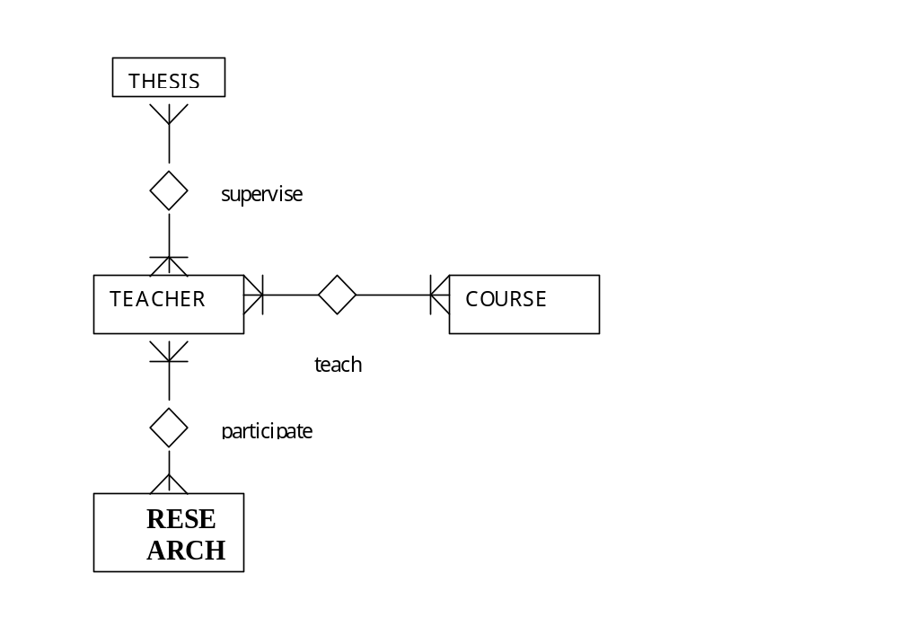
Examples
Example 1: teacher career management database.

Slide 83
Example 1: Teacher career management database
- TEACHER, THESIS, COURSE: nontemporal entity types
- RESEARCH_PROJ: an entity type with a lifespan.
- TEACH: a relationship type with valid-time.
- - PARTICIPATE: a relationship type with valid-time.
- - SUPERVISE: a relationship type with valid-time.
- Position: an attribute of TEACHER , this attibute is with a valid time.
- Trainning: an attribute of TEACHER , this attibute is with a valid time.
- Publication: an attribute of TEACHER , this attibute is with a valid time.
- Working_exp: an attribute of TEACHER , this attibute is with a valid time.

Slide 84
Example 1 (cont.)
Relational Schema
TEACHER(empno, name, addr,….)
COURSE(course_no, title, credits,…)
RESEARCH_PROJ(proj_no, proj_name, budget, time_start, time_end, chief)
THESIS(thesisno, title, student,…)
TEACH(empno, course_no, ts, te)
PARTICIPATE(empno, proj_no, role, ts, te)
SUPERVISE(empno, thesisno, role, ts, te)
TEACHER_POSTION(empno, pos, ts, te, result)
TEACHER_TRAINING(empno, training_course, ts, te)
TEACHER_PUBLICATION(empo, title, type, detail, timeofprint)
WORKING_EXPERIENCE(empno, job-title, orgnization, ts, te)

Slide 85
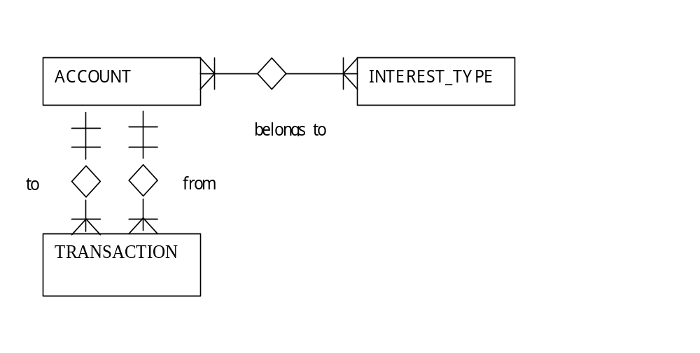
Example 2: Banking database
- ACCOUNT: nontemporal entity type
- INTEREST_TYPE: entity type with valid time
- TRANSACTION: event entity type.
- BELONGS_TO: relationship type with valid time
- Balance: an attribute (of ACCOUNT) with valid time

Slide 86
Example 2 (cont.)
Relational Schema:
ACCOUNT(acc-no, date_opened,…)
INTEREST_TYPE(int-type, int_rate, ts, te)
TRANSACTION(transaction-no, event-time, event_date, type, amount, from-acc-no, to-acc-no, …)
BELONGS_TO(acc_no, int_type, ts, te)
BALANCE(acc-no, ts, te, balance)

Slide 87
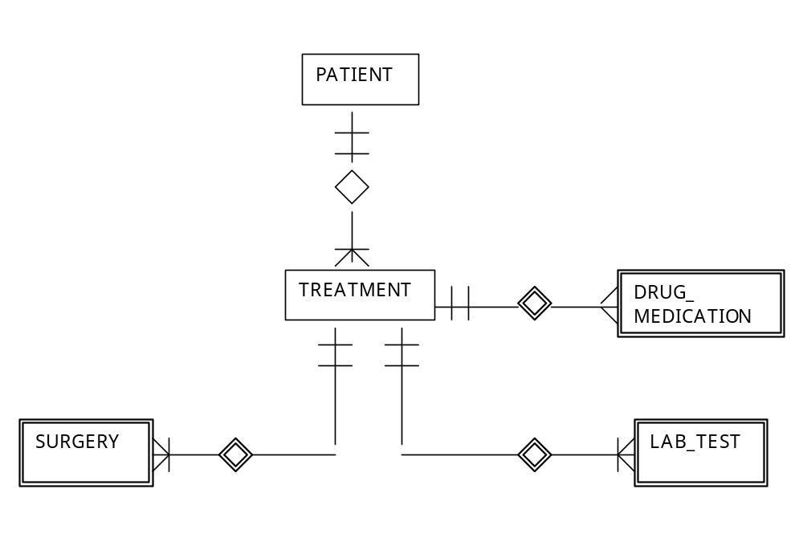
Example 3. Clinical Temporal Database

Slide 88
Example 3. (cont.)
- PATIENT: non-temporal entity type
- TREATMENT: an entity type with a lifespan
- DRUG_MEDICATION: an entity type with a lifespan
- SURGERY an entity type with a lifespan
- LAB_TEST: an event entity type.
Note: SURGERY, DRUG_MEDICATION, LAB_TEST are weak entity types dependent on the TREATMENT entity type.
- Bed-no: an attribute (of TREATMENT) with valid time.

Slide 89
Example 3. (cont.)
Relational Schema:
PATIENT(p-id, name, addr, sex, age,…)
TREATMENT(file-no, p-id, disease, ts, te)
DRUD_MEDICATION(file-no, drug, dosage, ts, te)
SURGERY(file-no, op-name, op-room, ts, te)
LAB_TEST(file-no, test-name, event-time,…)
BED(file-no, bed-number, ts, te)

Slide 90
HOW TO IMPLEMENT A TEMPORAL DATABASE APPLICATION
There are two commonly used methods to implement a temporal database application:
Method 1: Firstly, build a software layer which support the temporal data model and its temporal query language on top of a RDBMS (That means the layer can analyze and process the temporal queries. The main advantage of this method is the possibility of reusing the services of the RDBMS). Then develop the database application by utilizing the layer.
Method 2: After understanding all the complexity of temporal databases, the developer develops the application using directly the SQL language and the host language supplied by RDBMS. That means he has to deal with all the complexity of temporal databases in the application programs.

